Slide 1

8th Grade Math: Pre-Algebra
Unit 13, Lesson 1 Angle Relationships Volume 2, pg. 267

Slide 2


Benchmark
MA.8.GR.1.4
Solve mathematical problems involving the relationships between supplementary, complementary, vertical, or adjacent angles.
volume 2, pg. 267

Slide 3
Integrated Mathematical Thinking and Reasoning Standards
MA.K12.MTR.1.1 Actively participate in effortful learning both individually and collectively.
MA.K12.MTR.2.1 Demonstrate understanding by representing problems in multiple ways.
MA.K12.MTR.4.1 Engage in discussions that reflect on the mathematical thinking of self and others.
MA.K12.MTR.5.1 Use patterns and structure to help understand and connect mathematical concepts.
volume 2, pg. 267

Slide 4

Learning Target
I can identify adjacent, supplementary, complementary, and vertical angles.
volume 2, pg. 267

Slide 5

Warm-Up
volume 2, pg. 267

Slide 6
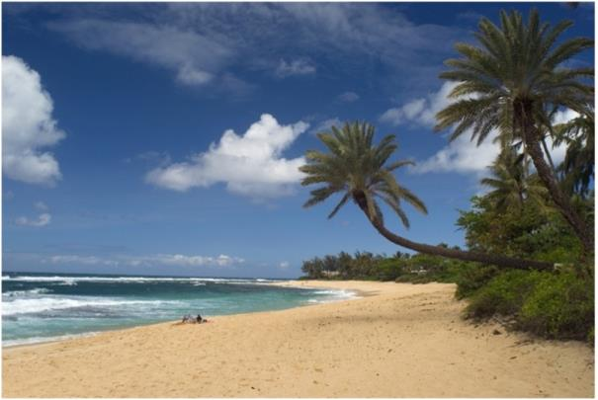
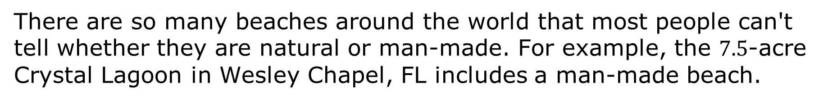
13.1.1 Warm-Up: Sandy Beaches
There are so many beaches around the world that most people can't tell whether they are natural or man-made. For example, the $7.5$-acre Crystal Lagoon in Wesley Chapel, FL includes a man-made beach.
volume 2, pg. 267

Slide 7
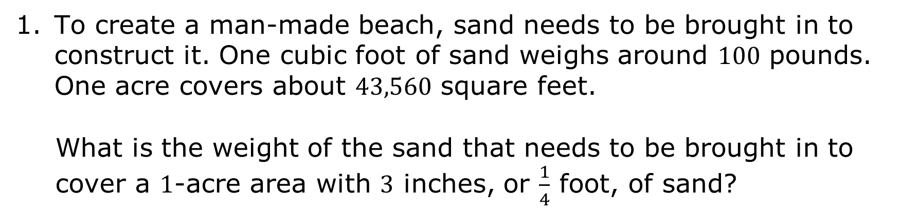
To create a man-made beach, sand needs to be brought in to construct it. One cubic foot of sand weighs around $100$ pounds. One acre covers about $43,560$ square feet.
What is the weight of the sand that needs to be brought in to cover a $1$-acre area with $3$ inches, or $\frac{1}{4}$ foot, of sand?
volume 2, pg. 267

Slide 8

Guided Instruction
volume 2, pg. 268

Slide 9
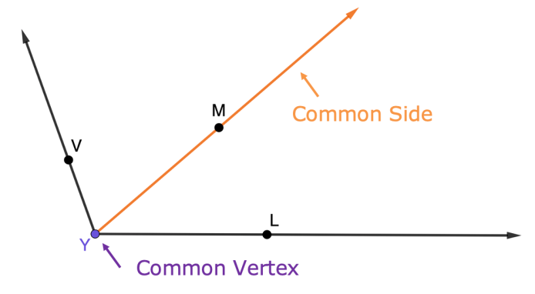
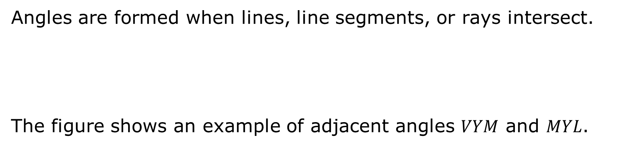
13.1.2 Guided Instruction: Adjacent Angles
Angles are formed when lines, line segments, or rays intersect.
The figure shows an example of adjacent angles $VYM$ and $MYL$.
Two angles that share a side and vertex and do not overlap are called adjacent angles.
volume 2, pg. 268

Slide 10
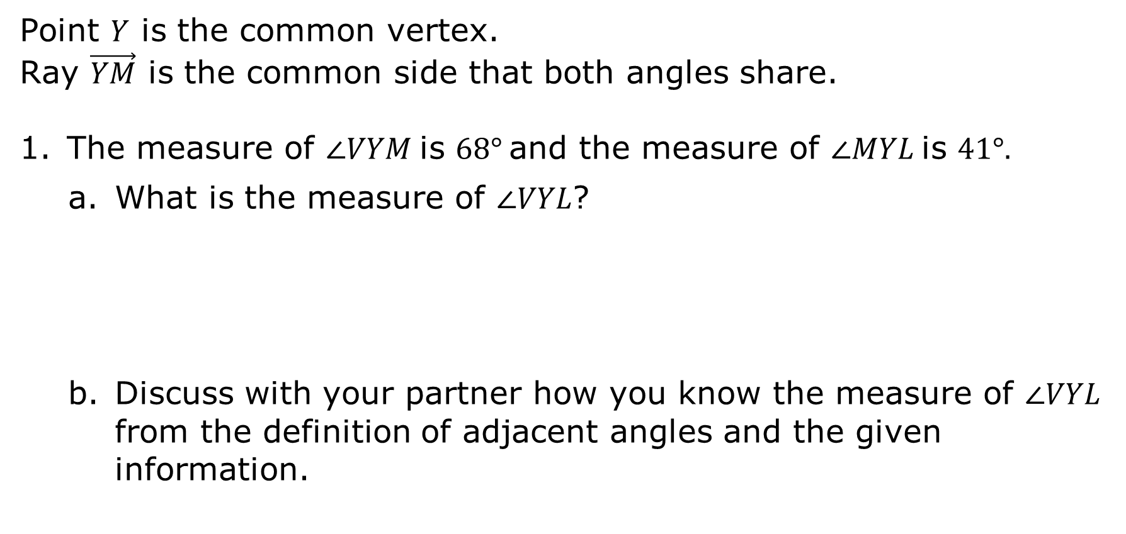
Point $Y$ is the common vertex.
Ray $\vec{YM}$ is the common side that both angles share.
The measure of $∠VYM$is $68°$and the measure of $∠MYL$is $41°.$
What is the measure of ∠𝑉𝑌𝐿?
Discuss with your partner how you know the measure of ∠𝑉𝑌𝐿 from the definition of adjacent angles and the given information.
volume 2, pg. 268

Slide 11
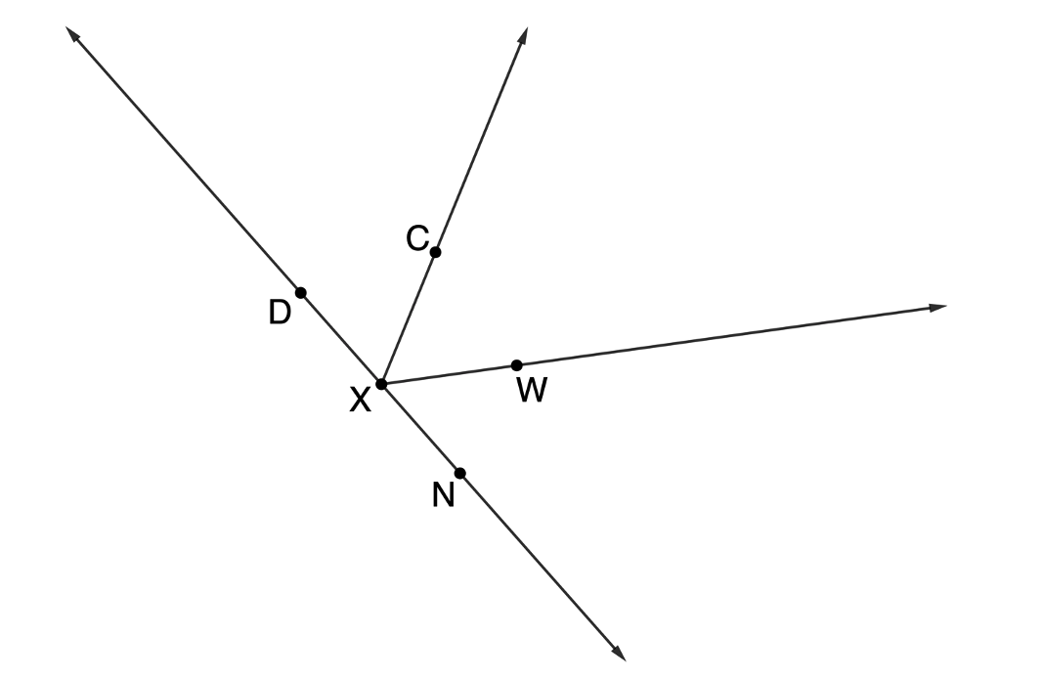

Line $DN$, ray $XC$, and ray $XW$ intersect to form angles, as shown.
volume 2, pg. 268

Slide 12
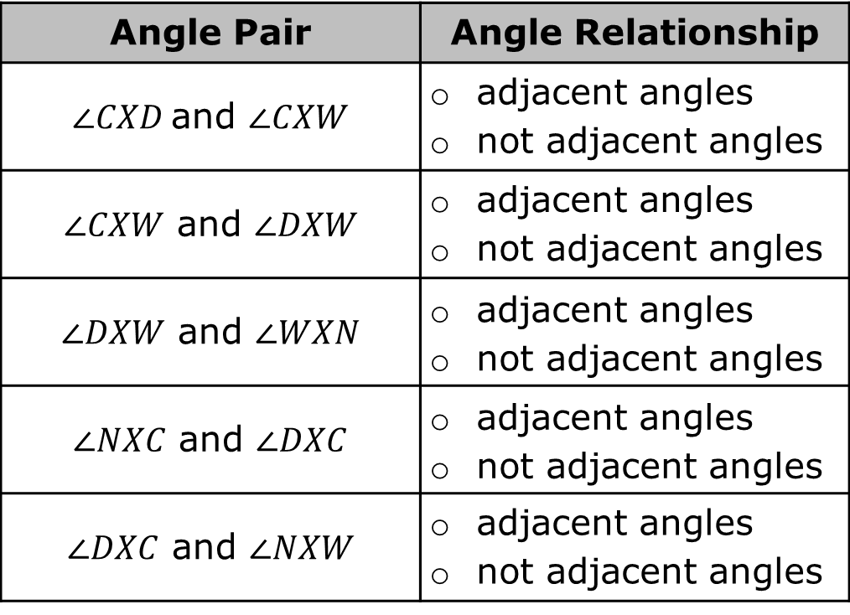
Complete the table to identify whether each pair of angles given are adjacent angles.
Angle Pair | Angle Relationship
$∠CXD$and $∠CXW$ | adjacent angles not adjacent angles
$∠CXW$ and $∠DXW$ | adjacent angles not adjacent angles
$∠DXW$ and $∠WXN$ | adjacent angles not adjacent angles
$∠NXC$ and $∠DXC$ | adjacent angles not adjacent angles
$∠DXC$ and $∠NXW$ | adjacent angles not adjacent angles
volume 2, pg. 268

Slide 13

Exploration
volume 2, pg. 269

Slide 14

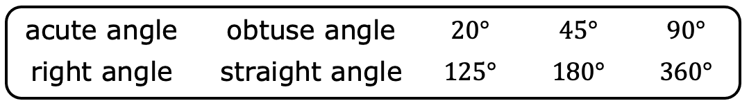
13.1.3 Exploration: Angle Relationships
Several angle names and measures are given in the bank below.
Work with your partner to complete the table by matching the angle name and measure from the bank to each type of angle shown. Some words and angle measures from the bank will not be used.
volume 2, pg. 269

Slide 15
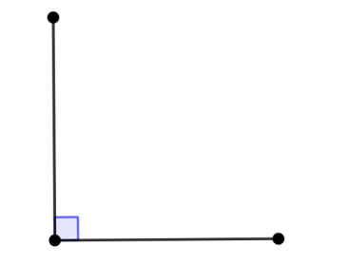
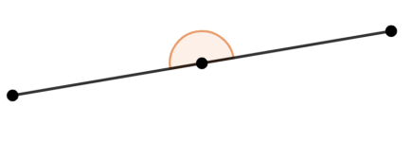
Image | Angle Name | Angle Measure
Your teacher will give you three rectangular pieces of paper to use for the remainder of the Exploration.
volume 2, pg. 269

Slide 16
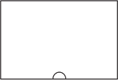
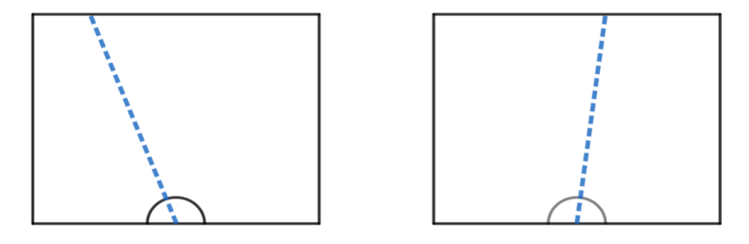
Use one rectangular piece of paper to complete the following.
Draw a small half-circle in the middle of one side, as shown.
Use a straightedge to draw a line starting from the center of the half-circle, all the way across the paper. The line can go in any direction or angle across the paper. Two possible examples are shown.
volume 2, pg. 269

Slide 17
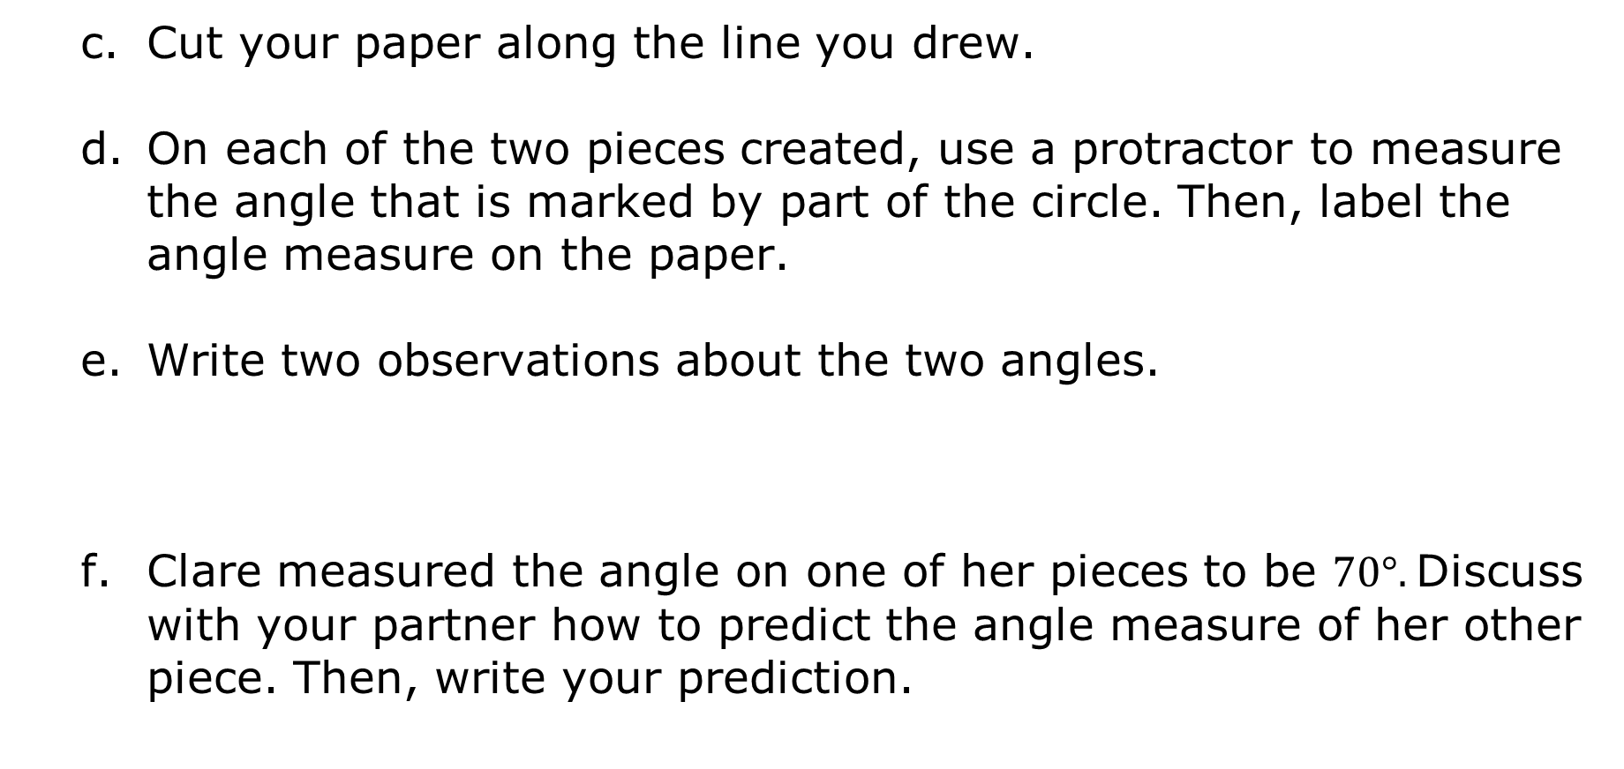
Cut your paper along the line you drew.
On each of the two pieces created, use a protractor to measure the angle that is marked by part of the circle. Then, label the angle measure on the paper.
Write two observations about the two angles.
Clare measured the angle on one of her pieces to be $70°.$Discuss with your partner how to predict the angle measure of her other piece. Then, write your prediction.
volume 2, pg. 269

Slide 18
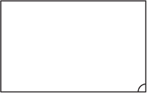
Use a second rectangular piece of paper to complete the following.
Draw a small quarter-circle in one of the corners.
Use a straightedge to draw a line starting from the vertex with the quarter-circle, all the way across the paper. The line can go in any direction or angle across the paper.
Cut your paper along the line you drew.
volume 2, pg. 270

Slide 19
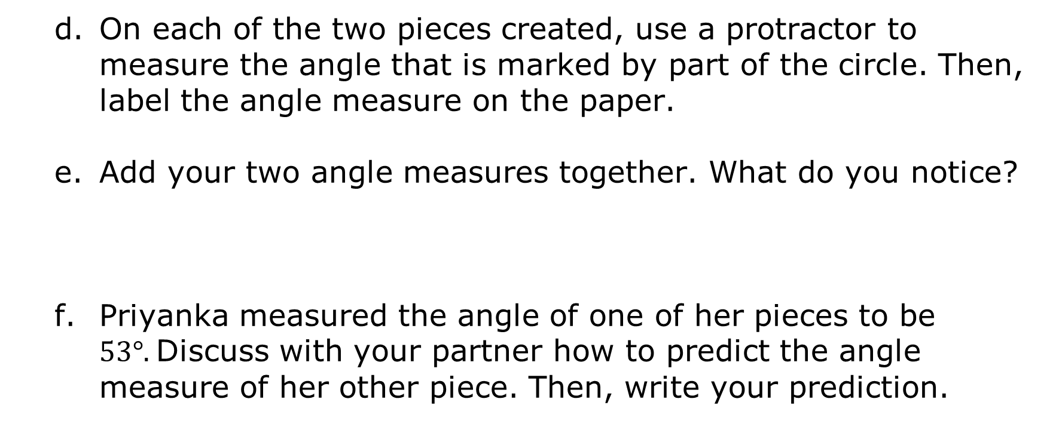
On each of the two pieces created, use a protractor to measure the angle that is marked by part of the circle. Then, label the angle measure on the paper.
Add your two angle measures together. What do you notice?
Priyanka measured the angle of one of her pieces to be $53°.$Discuss with your partner how to predict the angle measure of her other piece. Then, write your prediction.
volume 2, pg. 270

Slide 20
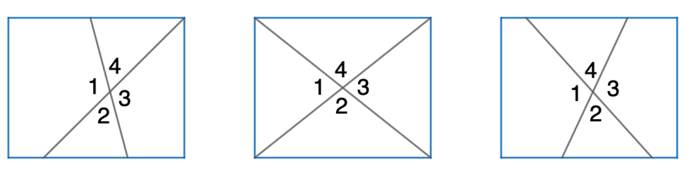
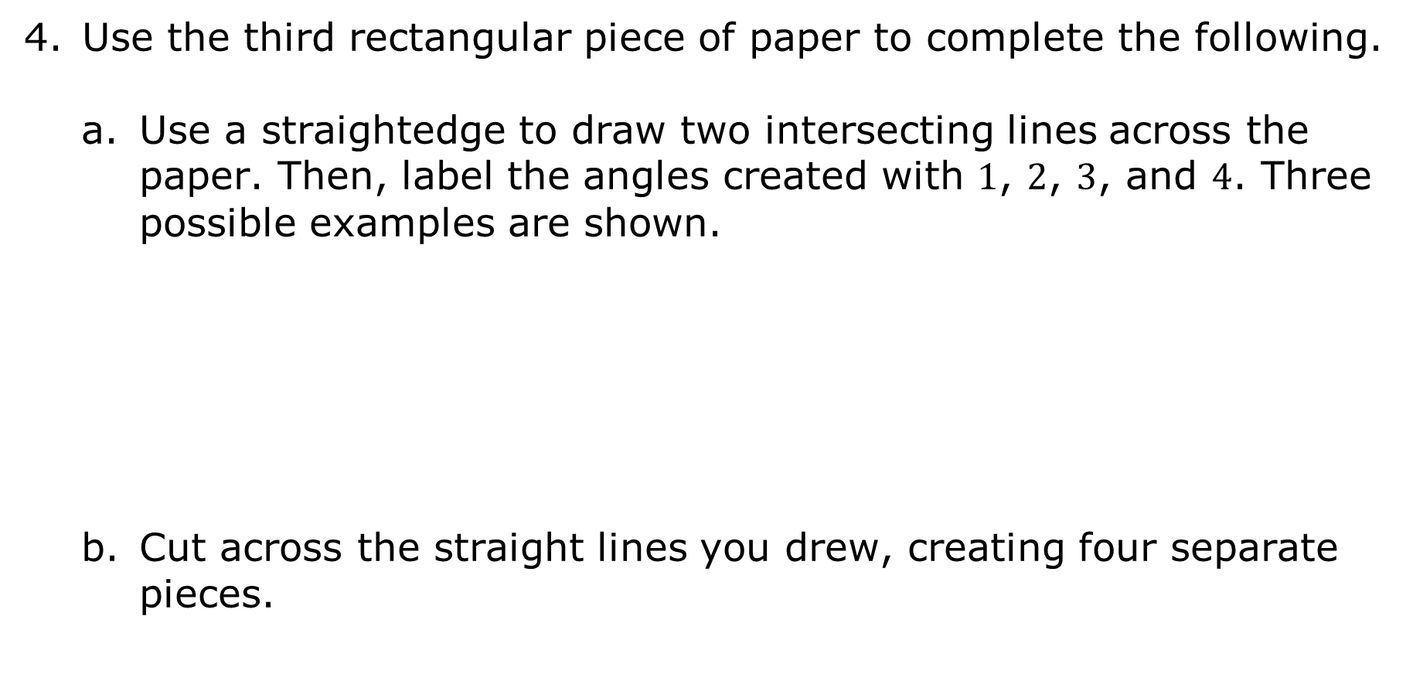
Use the third rectangular piece of paper to complete the following.
Use a straightedge to draw two intersecting lines across the paper. Then, label the angles created with $1$, $2$, $3$, and $4$. Three possible examples are shown.
Cut across the straight lines you drew, creating four separate pieces.
volume 2, pg. 270

Slide 21
Rotate and flip the angles to determine how they compare with each other. This could include laying angles on top of one another to compare their size. Summarize your observations of how the angles compare to each other.
Compare your findings with your partner. Make a conjecture about the relationship between angle measures when two lines intersect.
volume 2, pg. 270

Slide 22

Bring It Together
volume 2, pg. 271

Slide 23



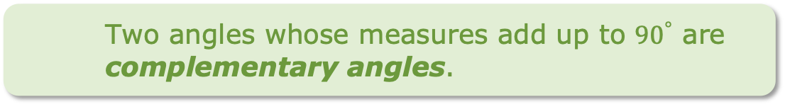

13.1.4 Bring It Together: Angle Relationships
Three different angle relationships were explored in the Exploration. Their definitions are shown.
Two angles whose measures add up to ${90}^{°}$ are complementary angles.
Two angles with measures that add up to exactly ${180}^{°}$ are supplementary angles.
Vertical angles are the opposite angles formed when two lines intersect.
volume 2, pg. 271

Slide 24
Complete the statements using the definitions of each angle relationship.
The angles created in question 2 of the Exploration are ______________________ angles.
The angles created in question 3 of the Exploration are ______________________ angles.
The angles created in question 4 of the Exploration are ______________________ angles.
volume 2, pg. 271

Slide 25
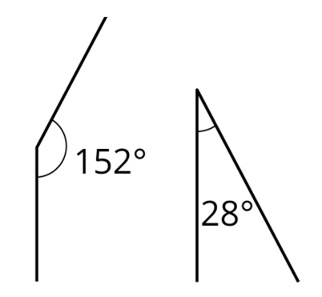
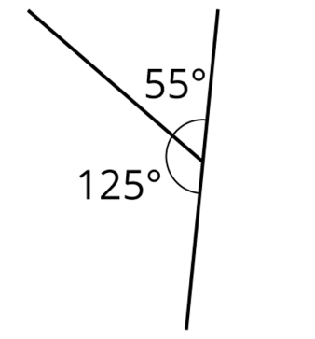
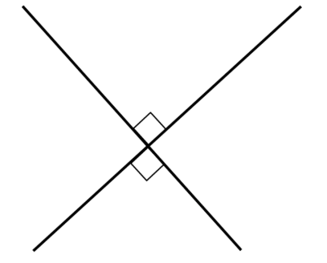
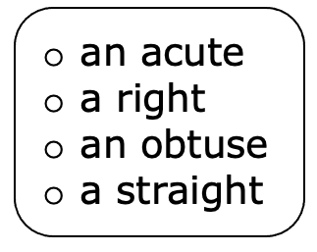
Supplementary angles can be adjacent or non-adjacent. Three examples of supplementary angles are shown, with the angles in each pair marked.
Complete the statement.
When supplementary angles are adjacent, they form angle together.
volume 2, pg. 271

Slide 26
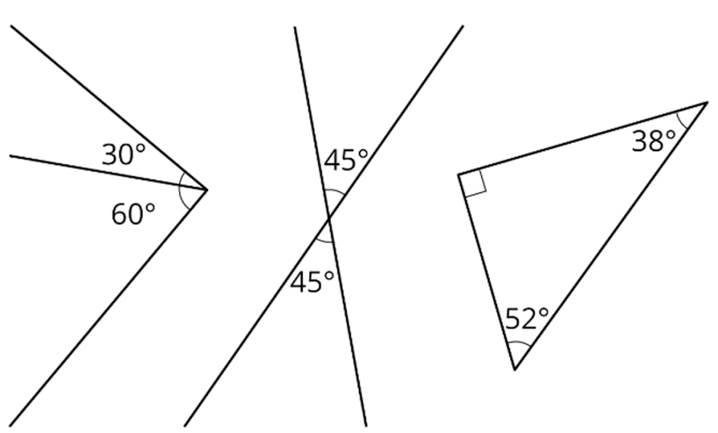
Three examples of complementary angles are shown. Complementary angles can be adjacent or non-adjacent.
Circle the example that shows an adjacent pair of complementary angles.
volume 2, pg. 271

Slide 27
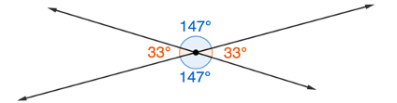
Complete the statement.
When complementary angles are adjacent, they form angle together.
Each pair of vertical angles formed by the intersecting lines below are shown in a different color.
volume 2, pg. 272

Slide 28
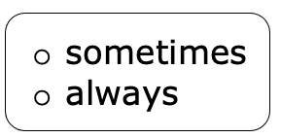

Discuss with your partner the angle relationship between adjacent angles when two lines intersect.
Complete the statements.
Vertical angles have equal measures. Pairs of adjacent angles created when two lines intersect are
volume 2, pg. 272

Slide 29

Wrap-Up
volume 2, pg. 272

Slide 30
13.1.5 Wrap-Up: Reflection
Complete the table.
The terms and information used in the lesson that I knew were … | Something I wondered during the lesson was … | Something I learned during the lesson was …
volume 2, pg. 272

